Slide 1
Object-Oriented Systems Development:
Using the Unified Modeling Language
Chapter 10:
Designing Classes
Object-Oriented Systems Development Bahrami © Irwin/ McGraw-Hill

Slide 2

Goals
Designing classes.
Designing protocols and class visibility.
Defining attributes.
Designing methods.
Object-Oriented Systems Development Bahrami © Irwin/ McGraw-Hill

Slide 3

Object-Oriented Design Philosophy
The first step in building an application should be to design a set of classes, each of which has a specific expertise and all of which can work together in useful ways.
Object-Oriented Systems Development Bahrami © Irwin/ McGraw-Hill

Slide 4
Designing Class: the Process
1. Apply design axioms to design classes, their attributes, methods, associations, structures, and protocols.
  1.1. Refine and complete the static UML class diagram (object model) by adding details to that diagram.
    1.1.1. Refine attributes.
    1.1.2. Design methods and the protocols by utilizing a UML activity diagram to represent the method's algorithm..
    1.1.3. Refine the associations between classes (if required).
    1.1.4. Refine the class hierarchy and design with inheritance (if required).
  1.2. Iterate and refine again.
Object-Oriented Systems Development Bahrami © Irwin/ McGraw-Hill

Slide 5
Class Visibility
In designing methods or attributes for classes, you are confronted with two issues.
  One is the protocol, or interface to the class operations and its visibility;
  and how it should be implemented.
Object-Oriented Systems Development Bahrami © Irwin/ McGraw-Hill

Slide 6
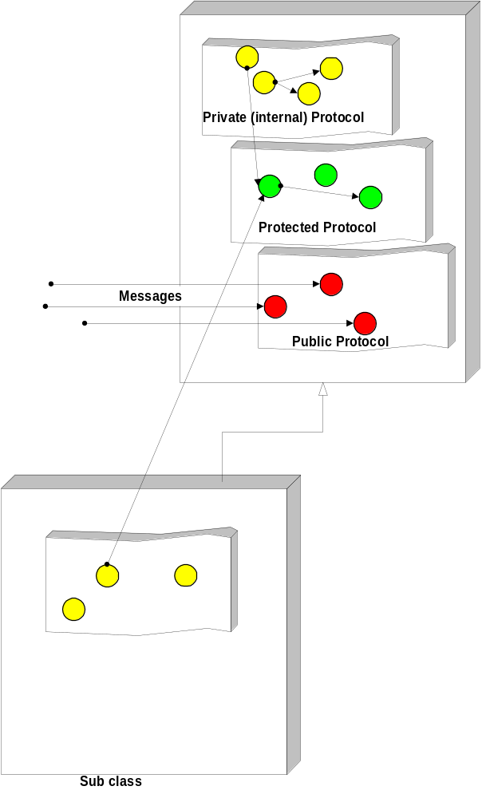
Class Visibility (Con’t)
Public protocols define the functionality and external messages of an object, while private protocols define the implementation of an object.
Object-Oriented Systems Development Bahrami © Irwin/ McGraw-Hill

Slide 7

Private Protocol (Visibility)
A set of methods that are used only internally.
Object messages to itself.
Define the implementation of the object (Internal).
Issues are: deciding what should be private.
  What attributes
  What methods
Object-Oriented Systems Development Bahrami © Irwin/ McGraw-Hill

Slide 8

Protected Protocol (Visibility)
In a protected protocol, subclasses can use the method in addition to the class itself.
In private protocols, only the class itself can use the method.
Object-Oriented Systems Development Bahrami © Irwin/ McGraw-Hill

Slide 9

Public Protocol (Visibility)
Defines the functionality of the object
Decide what should be public (External).
Object-Oriented Systems Development Bahrami © Irwin/ McGraw-Hill

Slide 10
Guidelines for Designing Protocols
Good design allows for polymorphism.
Not all protocols should be public, again apply design axioms and corollaries.
Object-Oriented Systems Development Bahrami © Irwin/ McGraw-Hill

Slide 11
Guidelines for Designing Protocols (Con’t)
The following key questions must be answered:
  What are the class interfaces and protocols?
  What public (external) protocol will be used or what external messages must the system understand?
Object-Oriented Systems Development Bahrami © Irwin/ McGraw-Hill

Slide 12

Questions (Con’t)
  What private or protected (internal) protocol will be used or what internal messages or messages from a subclass must the system understand?
Object-Oriented Systems Development Bahrami © Irwin/ McGraw-Hill

Slide 13
Attribute Types
The three basic types of attributes are:
  1. Single-value attributes.
  2. Multiplicity or multivalue attributes.
  3. Reference to another object, or instance connection.
Object-Oriented Systems Development Bahrami © Irwin/ McGraw-Hill
Notes:
Attributes represent the state of an object. When the state of the object changes, these changes are reflected in the value of attributes. The single-value attribute is the most common attribute type. It has only one value or state. For example, attributes such as name, address, or salary are of the single-value type.
The multiplicity or multivalue attribute is the opposite of single-value attribute since, as its name implies, it can have a collection or many values at any point in time [2]. For example, if we want to keep track of the names of people who have called a customer support line for help, we must use the multivalues attributes.
Instance connection attributes are required to provide the mapping needed by an object to fulfill its responsibilities. In other words, instance connection model association. For example, a person might have one or more bank accounts. A person has zero to many instance connections to Account(s). Similarly, an Account can be assigned to one or more persons (i.e., joint account). Therefore, an Account also has zero to many instance connections to Person(s).

Slide 14
Designing Methods and Protocols
A class can provide several types of methods:
  Constructor. Method that creates instances (objects) of the class.
  Destructor. The method that destroys instances.
  Conversion method. The method that converts a value from one unit of measure to another.
Object-Oriented Systems Development Bahrami © Irwin/ McGraw-Hill

Slide 15
Designing Methods and Protocols (Con’t)
  Copy method. The method that copies the contents of one instance to another instance.
  Attribute set. The method that sets the values of one or more attributes.
  Attribute get. The method that returns the values of one or more attributes.
Object-Oriented Systems Development Bahrami © Irwin/ McGraw-Hill

Slide 16
Designing Methods and Protocols (Con’t)
  I/O methods. The methods that provide or receive data to or from a device.
  Domain specific. The method specific to the application.
Object-Oriented Systems Development Bahrami © Irwin/ McGraw-Hill

Slide 17

Five Rules For Identifying Bad Design
I. If it looks messy then it's probably a bad design.
Object-Oriented Systems Development Bahrami © Irwin/ McGraw-Hill

Slide 18

Five Rules For Identifying Bad Design (Con’t)
II. If it is too complex then it's probably a bad design.
Object-Oriented Systems Development Bahrami © Irwin/ McGraw-Hill

Slide 19

Five Rules For Identifying Bad Design (Con’t)
III. If it is too big then it's probably a bad design.
Object-Oriented Systems Development Bahrami © Irwin/ McGraw-Hill

Slide 20

Five Rules For Identifying Bad Design (Con’t)
IV. If people don't like it then it's probably a bad design.
Object-Oriented Systems Development Bahrami © Irwin/ McGraw-Hill

Slide 21

Five Rules For Identifying Bad Design (Con’t)
V. If it doesn't work then it's probably a bad design.
Object-Oriented Systems Development Bahrami © Irwin/ McGraw-Hill

Slide 22

Avoiding Design Pitfalls
Keep a careful eye on the class design and make sure that an object's role remains well defined.
If an object loses focus, you need to modify the design.
Apply Corollary 2 (single purpose).
Object-Oriented Systems Development Bahrami © Irwin/ McGraw-Hill

Slide 23
Avoiding Design Pitfalls (Con’t)
Move some functions into new classes that the object would use.
Apply Corollary 1 (uncoupled design with less information content).
Break up the class into two or more classes.
Apply Corollary 3 (large number of simple classes).
Object-Oriented Systems Development Bahrami © Irwin/ McGraw-Hill

Slide 24

Summary
This chapter concentrated on the first step of the object-oriented design process, which consists of applying the design axioms and corollaries to design classes, their attributes, methods, associations, structures, and protocols; then, iterating and refining.
Object-Oriented Systems Development Bahrami © Irwin/ McGraw-Hill

Slide 25
Summary (Con’t)
Object-oriented design is an iterative process.
Designing is as much about discovery as construction.
Do not be afraid to change a class design, based on experience gained, and do not be afraid to change it a second, third, or fourth time.
Object-Oriented Systems Development Bahrami © Irwin/ McGraw-Hill

